Slide 1
Hashing as a Dictionary Implementation
Chapter 13

Slide 2

Chapter Contents
What is Hashing?
Hash Functions
  Computing Hash Codes
  Compression a Hash Code into an Index for the Hash Table
Resolving Collisions
  Open Addressing with Linear Probing
  Open Addressing with Quadratic Probing
  Open Addressing with Double Hashing
  A Potential Problem with Open Addressing
  Separate Chaining

Slide 3
Chapter Contents (ctd.)
Efficiency
  The Load Factor
  The Cost of Open Addressing
  The Cost of Separate Chaining
Rehashing
Comparing Schemes for Collision Resolution
A Dictionary Implementation that Uses Hashing
  Entries in the Hash Table
  Data Fields and Constructors
  The Methods getValue, remove, and addIterators
Java Class Library: the Class HashMap

Slide 4

What is Hashing?
A technique that determines an index or location for storage of an item in a data structure
The hash function receives the search key
  Returns the index of an element in an array called the hash table
  The index is known as the hash index
A perfect hash function maps each search key into a different integer suitable as an index to the hash table

Slide 5
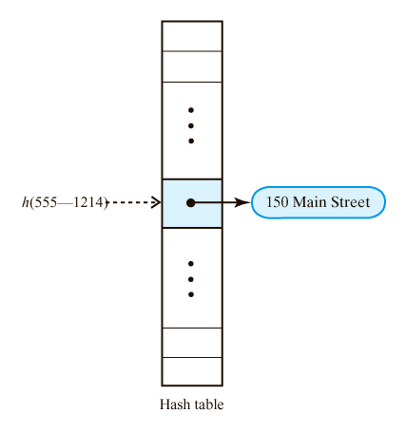
What is Hashing?
A hash function indexes its hash table.

Slide 6
What is Hashing?
How about a small town only needs 700 telephone numbers, most of the 10,000 hash table would be unused. Want to have a smaller hash table with only 700 entries.
Algorithm getHashIndex(phoneNumber)
  // return an index to an array of tableSize location
  i = last four digits of phone number
  return i % tableSize

Slide 7
What is Hashing?
Two steps of the hash function
  Convert the search key into an integer called the hash code
  Compress the hash code into the range of indices for the hash table
Typical hash functions are not perfect
  They can allow more than one search key to map into a single index
  This is known as a collision

Slide 8
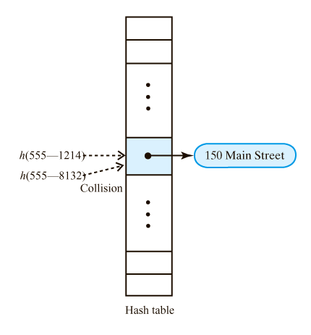
What is Hashing?
A collision caused by the hash function h

Slide 9
Hash Functions
General characteristics of a good hash function
  Minimize collisions
  Distribute entries uniformly throughout the hash table
  Be fast to compute

Slide 10
Computing Hash Codes
We will override the hashCode method of Object
Return an int value based on the invoking object’s memory address. Equal but distance object will have different hash code
Guidelines
  If a class overrides the method equals, it should override hashCode
  If the method equals considers two objects equal, hashCode must return the same value for both objects
  If an object invokes hashCode more than once during execution of program on the same data, it must return the same hash code

Slide 11
Computing Hash Codes
Search keys are often string. The hash code for a string, s. Two typical hash functions:
  sum the Unicode values for each letter. For example, assign 1 to 26 to “A”~”Z” . See any problem? KSW, WSK
  A better approach: multiplying each unicode for each letter by a factor based on location
Hash code for a primitive type
  Use the primitive typed key itself. Do Casting if not integer type
  Contains more than 32 bits, casting will lose first 32 bits. What should we do?
  Manipulate internal binary representations
  Combine pieces use folding
    (int) (key ^ ( key >> 32))
      ^ exclusive-or
      >> shift to the right
      << shift to the left

Slide 12
Compressing a Hash Code
Must compress the hash code so it fits into the index range
Typical method for a code c is to compute c modulo n: c % n
  Index will then be between 0 and n – 1
  If n is even, c % n has the same parity as c
  n is a prime number (the size of the table)
The size of a hash table should be a prime number n greater than 2 and is odd. Then you compress a positive hash code c into an index for the table by using c % n, the indices will be distributed uniformly between 0 and n-1

Slide 13
Compressing a Hash Code
private int getHashIndex(K key)
{
  int hashIndex = key.hashCode() % hashTable.length;
  if ( hashIndex < 0 )
hashIndex = hashIndex + hashTable.length;
return hashIndex;
}
One final detail:
If c is negative, c % n lies between 1-n and 0. Add n to it so that it lies between 1 and n-1.

Slide 14
Resolving Collisions
Options when hash functions returns location already used in the table
  Use another location in the table
  Change the structure of the hash table so that each array location can represent multiple values

Slide 15
Open Addressing with Linear Probing
Open addressing scheme locates alternate location
  New location must be open, available
Linear probing
  If collision occurs at hashTable[k], look successively at location k + 1, k + 2, …
  Examine consecutive locations beginning at the original hash index – to find the next available one.

Slide 16
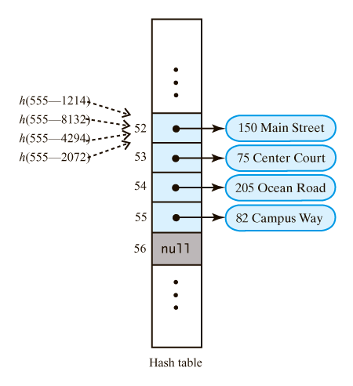
Open Addressing with Linear Probing
Retrievals? ?
The effect of linear probing after adding four entries whose search keys hash to the same index.

Slide 17
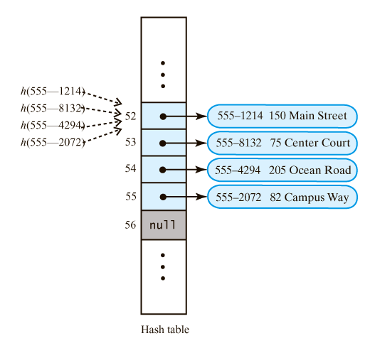
Open Addressing with Linear Probing
A revision of the hash table when linear probing resolves collisions; each entry contains a search key and its associated value

Slide 18
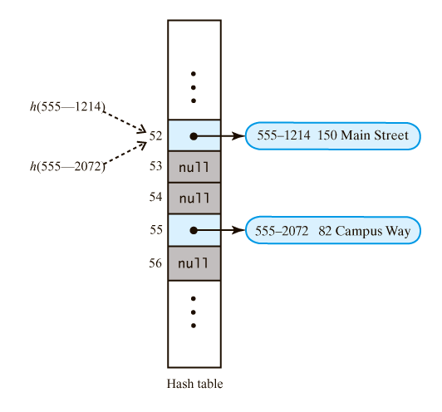
Removals
A hash table if remove used null to remove entries. How about if we try to retrieve h(555-2072)?

Slide 19
Removals
We need to distinguish among three kinds of locations in the hash table
Occupied
  The location references an entry in the dictionary
Empty
  The location contains null and always did
Available
  The location's entry was removed from the dictionary and is now available for use

Slide 20
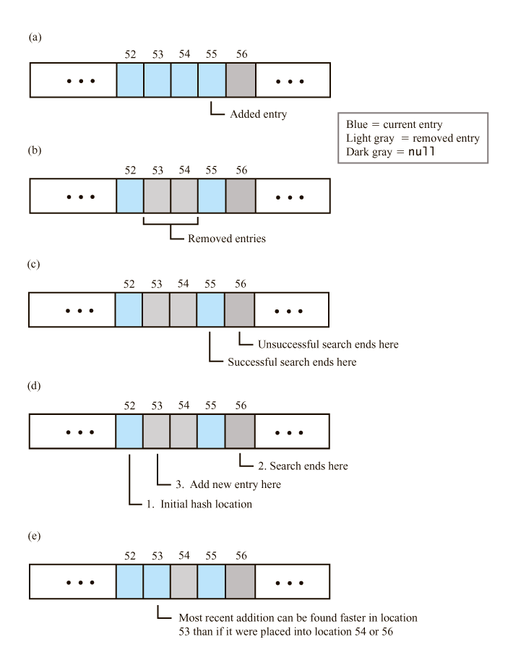
Open Addressing with Linear Probing
A linear probe sequence (a) after adding an entry; (b) after removing two entries;

Slide 21
Open Addressing with Linear Probing
A linear probe sequence (c) after a search; (d) during the search while adding an entry; (e) after an addition to a formerly occupied location.

Slide 22
Searches that Dictionary Operations Require
To retrieve an entry
  Search the probe sequence for the key
  Examine entries that are present, ignore locations in available state
  Stop search when key is found or null reached
To remove an entry
  Search the probe sequence same as for retrieval
  If key is found, mark location as available
To add an entry
  Search probe sequence same as for retrieval
  Note first available slot
  Use available slot if the key is not found

Slide 23
Linear probing causes primary clustering
Linear probing is apt to cause primary clustering.
Each cluster is a group of consecutive and occupied locations in the hash table.
During an addition, any collision within a cluster causes the cluster to get larger
Avoid primary clustering by using quadratic probing

Slide 24
Open Addressing, Quadratic Probing
Change the probe sequence
  Given search key k
  Probe to k + 1, k + 2², k + 3², … k + n²
Separate entries in the probe sequence
For avoiding primary clustering
  But can lead to secondary clustering, since entries that collide with an existing entry use the same probe sequence.

Slide 25

Open Addressing, Quadratic Probing
A probe sequence of length 5 using quadratic probing.
Avoid primary clustering but can lead to secondary clustering

Slide 26
Open Addressing with Double Hashing
Resolves collision by examining locations
  At original hash index
  Plus an increment determined by 2nd function
Second hash function
  Different from first
  Depends on search key
  Returns nonzero value
Reaches every location in hash table if table size is prime
Avoids both primary and secondary clustering

Slide 27
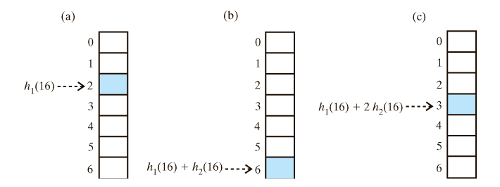
Open Addressing with Double Hashing
h1(key) = key modulo 7; h2(key) = 5- key modulo 5
h1(16) =2; h2(16)= 4;
The first three locations in a probe sequence generated by double hashing for the search key.

Slide 28
Potential problem with open address
Frequent addition and removals can cause every location in the hash table to reference either a current entry or a former entry. That is no location that contains null.
If this happens, our approach to search a probe sequence will not work. Unsuccessful search should end at null, this case it has to search all locations.

Slide 29
Separate Chaining
Alter the structure of the hash table
Each location can represent multiple values
  Each location called a bucket
Bucket can be a(n)
  List
  Sorted list
  Chain of linked nodes
  Array
  Vector

Slide 30
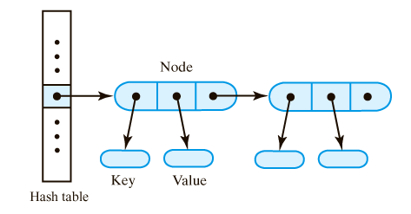
Separate Chaining
A hash table for use with separate chaining; each bucket is a chain of linked nodes.

Slide 31
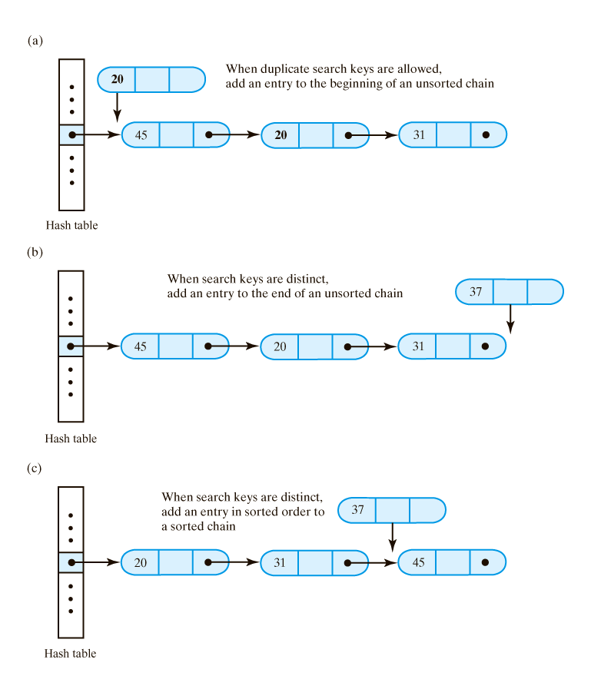
Separate Chaining
Where new entry is inserted into linked bucket when integer search keys are (a) duplicate and unsorted;

Slide 32
Separate Chaining
Where new entry is inserted into linked bucket when integer search keys are (b) distinct and unsorted;

Slide 33
Separate Chaining
Where new entry is inserted into linked bucket when integer search keys are (c) distinct and sorted

Slide 34
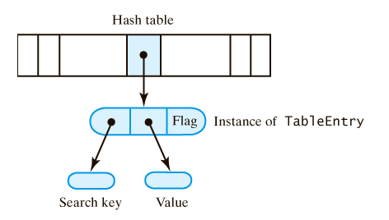
A Dictionary Implementation That Uses Hashing
A hash table and one of its entry objects

Slide 35
Java Class Library: The Class HashMap
Assumes search-key objects belong to a class that overrides methods hashCode and equals
Hash table is collection of buckets
Constructors
  public HashMap()
  public HashMap (int initialSize)
  public HashMap (int initialSize,
  float maxLoadFactor)
  public HashMap (Map table)

